Slide 1
Committee Overview
Tim Henkel

Slide 2
Structure
Committee on Performance-Based Management
Leadership Group
Technical Subcommittees
Work Groups
Asset Management Chair: Matt Haubrich
Vice: Martin Kidner
Risk Management Chair: Travis McGrath Vice: Jean Wallace
Policy & Rulemaking
Research
Organizational Management
Co-Chair: Charlie Purcell
Co-Chair: Deana Belden
System Mobility and Emerging Technologies
Chair: Daniela Bremmer
Vice: Jay Styles
Professional Development

Slide 3
Leadership
Chair: Tim Henkel, MN
Vice Chair: Christos Xenophontos, RI
Secretary: Karen Miller, MO
Leadership Group
Comprised of subcommittee chairs and vice-chairs
Meetings: Fourth Tuesday at 12:30pm

Slide 4
Technical Subcommittees
Asset Management
Chair: Matt Haubrich, IA
Meetings: First Friday at 10:00am* (joint with TRB)
Organizational Management
Co-Chairs: Charlie Purcell, IA and Deanna Belden, MN
Meetings: Third Tuesday at 12:00pm*
Risk Management
Chair: Travis McGrath, ID; Vice-Chair: Jean Wallace, MN
Meetings: Even Months, Second Monday at 2:00pm*
System Mobility and Emerging Technologies
Chair: Daniela Bremmer, WA; Vice-Chair: TBD
Meetings: TBD (joint with AASHTO CTSO)
*All times are Eastern

Slide 5
Work Groups
Policy and Rulemaking
Co-Chairs: Lynn Zanto, MT and Paul Degges, TN
Meetings: As Needed on Second Tuesday at 1:00pm
Professional Development
Chair: John Selmer, IA; Vice-Chair: TBD
Meetings: As Needed
Research
Chair: Tammy Haas, NM
Meetings: As Needed on Second Friday at 10:00am

Slide 6
Updates and Changes
Matthew Hardy

Slide 7
What’s Different?
Charter
Updated and being sent to AASHTO SMC for approval.
Action Plan → Working On It!
Regular Conference Calls

Slide 8
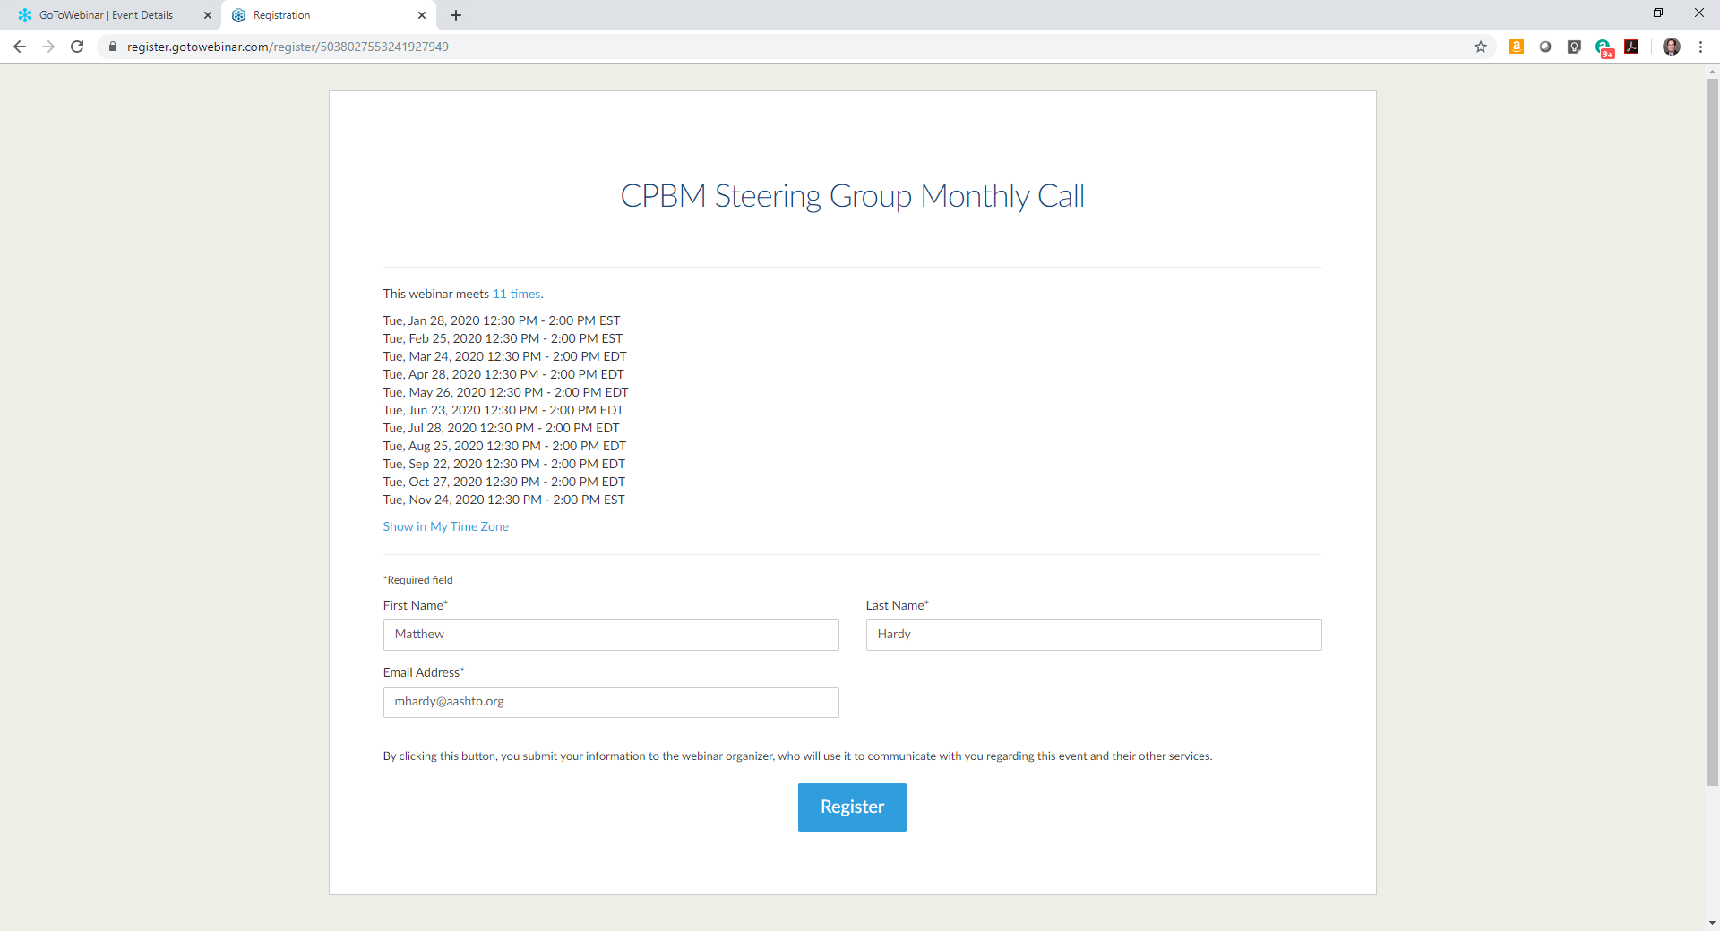
These dates may change due to:
Known Conflicts (e.g., holidays)—These changes will be reflected in the original registration but may get updated later.
Last-Minute Changes—These changes will be near the time/date of the event. Emails will be sent from GotoWebinar and follow-up from Matt Hardy.

Slide 9
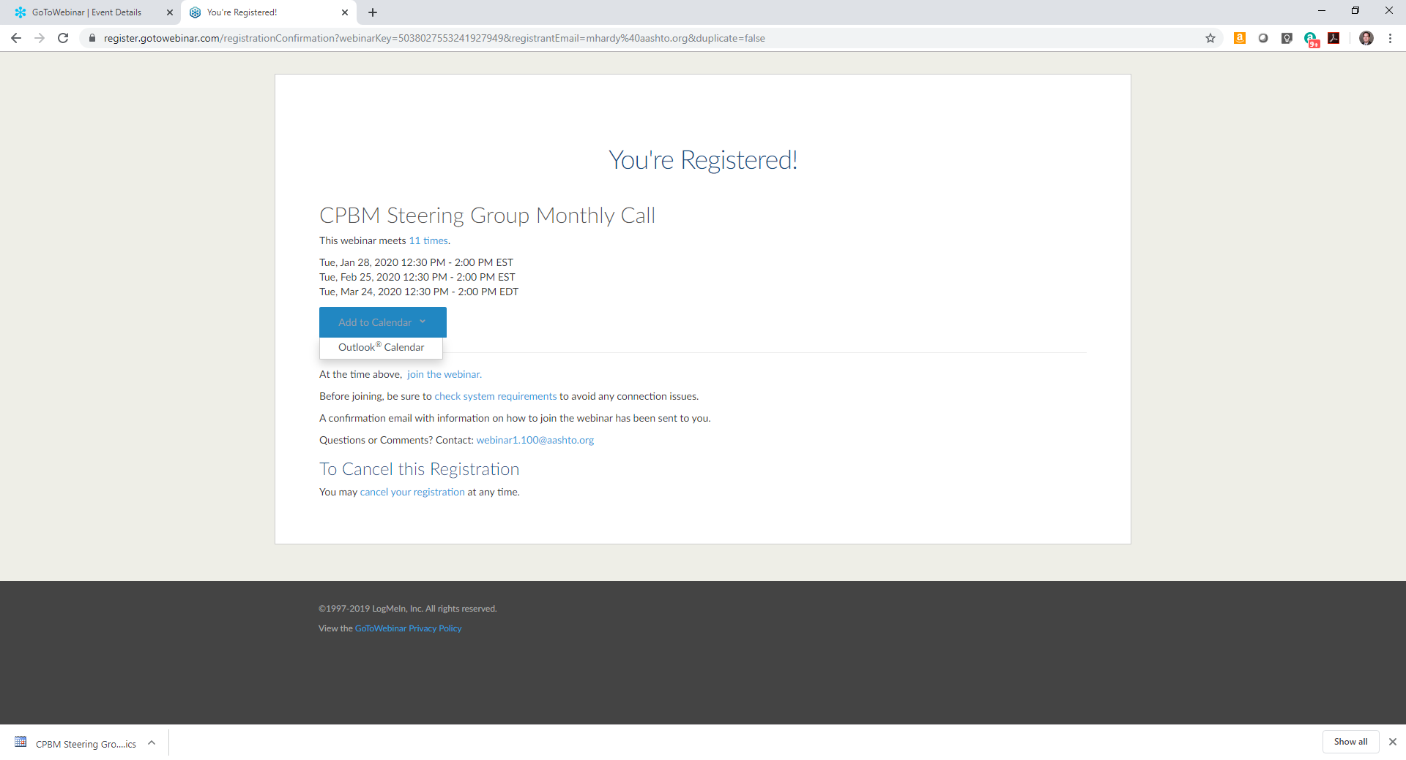
You have to add these to your calendar!

Slide 10
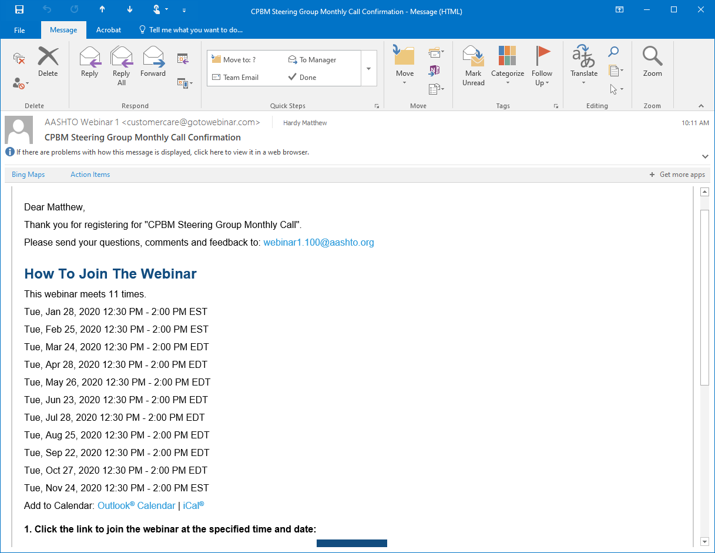
If you forget to add them to your calendar at the time of registration, you also get an email and can do the same thing!
NOTE: The email comes from GotoWebinar and not Matt Hardy!

Slide 11
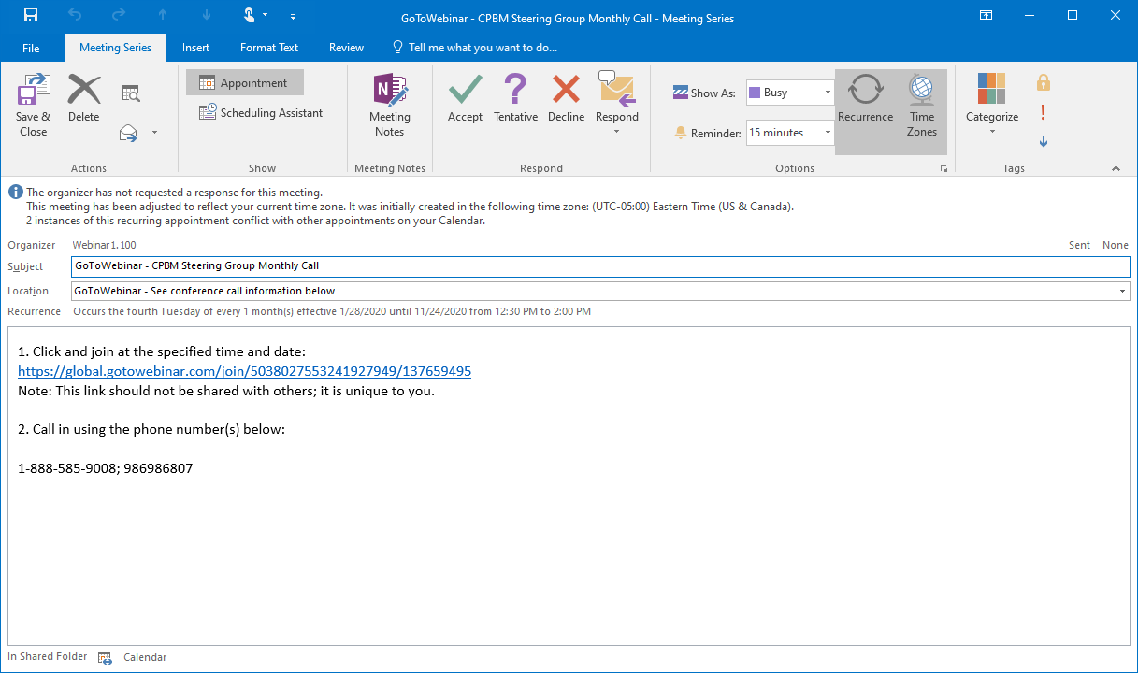
This is the calendar appointment as it appears once you “Add it” Outlook.
DON’T FORGET TO SAVE IT!

Slide 12
FHWA Update
Susanna Hughes-Reck

Slide 13
FHWA PM3 GIS Tool Demonstration
Michael Nesbitt

Slide 14
Subcommittee Updates

Slide 15
Asset Management Subcommittee
Leadership
Matt Haubrich, Iowa DOT
Martin Kidner, Wyoming DOT
Meetings
First Friday at 10:00am EASTERN
Looking to move to later time to accommodate West Coast
Activities
Research Projects (Development to Implementation)
Professional Development and Capacity Building
Policy and Regulations
Joint activities with the TRB Asset Management Committee
July 2020: 13th National TAM Conference
Membership
Would like one person from each state to participate

Slide 16
Organizational Management Subcommittee
Co-chairs: Deanna Belden and Charlie Purcell
Mission:
Help agencies achieve organizational excellence and advance the practice of performance excellence by identifying, analyzing and sharing information to improve organizational performance at the strategic, tactical and operational levels of the organization.
Goals:
Assist agencies to achieve strategic goals in the most effective and efficient way.
Examine and share effective organizational models, leadership structures and competencies used to monitor, respond to and implement organizational improvement.
Provide agencies with best practices in the application of process/quality improvement tools and methodologies.
Activities:
Activity 1, Process Improvement – Gary Vansuch
Activity 2, Informed Decision Making and Communications – Jack Smith
Activity 3, Research – Michael Nesbitt, FHWA Liaison
Meetings:
Joint meetings with TRB ABC20, Standing Committee on Management and Productivity
3rd Tuesday of the month, 11:00-12:30 Central

Slide 17
Risk Management Subcommittee
Leadership:
Travis McGrath, IA (Chair) and Jean Wallace, MN (Vice)
Purpose:
The Subcommittee on Risk Management is intended to advance the state of risk management practice in state DOTs through research and implementation assistance.
Membership:
People from FHWA and the following state DOTs are active with SRM: California, Colorado, Connecticut, Idaho, Illinois, Iowa, Minnesota, New Jersey, New York, Texas, Utah, Vermont, and Wyoming
Meetings
Second Monday of Even Months at 1:00pm

Slide 18
Activities
Joint meeting in August between TSSR, CTSO, and SRM
A lot of in interest in risks related to system resiliency and connected/automated vehicles
Discussions generated ideas for several research problem statements, which we’re pursuing now
Everyone agreed that research needs to be practical and easily implemented within DOTs
We’re launching two new research projects
NCHRP 20-123(04), Strategic Planning Session and Development of a Risk-Management Research Roadmap. Status: the project panel has been selected. The panel will meet in December to develop and issue the RFP for the project.
NCHRP 23-09, Scoping Study to Develop the Basis for a Highway Standard to Conduct an All-Hazards Risk and Resilience Analysis. Status: the project panel has been selected. The panel’s first meeting is January 29-30, 2020.

Slide 19
Activities (cont.)
We’ve prepared problem statements for several other proposed research projects
Building Risk-Management Momentum in an Agency. Status: submitted problem statement on November 1, 2019 for NCHRP consideration in FY21.
Prioritization of Risks Related to Connected and Automated Vehicles and Emerging Technologies. Status: submitted problem statement on November 1, 2019 for NCHRP consideration in FY21.
Legal Issues Concerning Risk Identification. Status: submitted problem statement on November 1, 2019 for NCHRP consideration in FY21.
Implementation of the AASHTO Guide for Enterprise Risk Management (ERM)
This implementation project is being led by a contractor
The intent is to advance the state of ERM within state DOTs
The project is funding three states for ERM pilot implementation, plus forming a Community of Practice (CoP) for ongoing peer implementation support
The project held its first in-person update and CoP meeting in November. A summary and feedback are being prepared.
The project will likely continue for another year, after which SRM will continue the CoP.

Slide 20
System Mobility and Emerging Technologies
Purpose:
Serve as the central forum to share information on how state DOTs are managing system operation and system mobility and how performance is impacted due to current and emerging transportation technologies, programs, operational strategies and connected environments.
Joint subcommittee on Operations and Performance Management Committee
Leadership:
Daniela Bremmer, Chair, Washington State DOT (Committee on Transportation System Operations)
Jay Styles, Vice Chair, Virginia DOT (Committee on Performance-Based Management)
Goals:
Share information and practices
Identify emerging transportation technology issues
Examine agency policy issues
Define key gaps (research, policy, etc.)
Meetings:
First Coordination Meeting: Thursday, December 19 at 1:00pm EASTERN
Recurring: TBD

Slide 21
TPM Pooled Fund
Christos Xenophontos

Slide 22
Primary Tasks
Information Clearinghouse
TPM Portal
Knowledge Development
Web-based tools
Training (web and in-person)
Knowledge Transfer
Peer Exchanges
PM3 Analytical Tools
UMD CATT Lab

Slide 23
TPM Portal
TPM practitioner resources and tools
TPM Now! Video series
TPM Pooled Fund secure member page
Calendar of TPM Deadlines
Notes:
Added resources: includes:
events, publications, CPBM Committee documents, state DOT examples
TPM Now! video series of TPM leaders and practitioners – includes Tim Henkel, Carlos Braceras, Julie Lorenz, more coming soon
Private TPM member page includes content for pooled fund members
Calendar of TPM deadlines related to target setting and reporting requirements

Slide 24
MODAT Web Tool
https://multiobjective.org
Notes:
One resource provided on portal is MODAT. It is a free web-based tool developed through NCHRP project 08-103 to assist in trade off decision-making.
Through the pooled fund, an excel-based tool was converted into a web-based tool that is available to all agencies.
MODA:
Structured approach for choosing between a set of alternatives considering multiple objectives
Approach for supporting TPM Framework Area 4.2 – Programming Across Program Areas
FHWA TPM TAP used the tool as a part of their workshop series.

Slide 25
Member Outreach
TPM Newsletter
Quarterly
Webinars
Peer Exchange
Notes:
Monthly TPM Newsletter to share features highlights of recent accomplishments, news, a spotlight on TPM practice, and action items, survey question of the month!
Quarterly informational webinars with members – next webinar is January 23rd 2020 – 2PM EST

Slide 26
TPM Pooled Fund Peer Exchange
Location: St. Paul, MN
Dates: November 14-15, 2019
Participants: 35 participants from 22 member agencies
Purpose:
Explore how agencies are implementing TPM in light of federal requirements
Advance TPM and performance-based planning and programming (PBPP) practice
Peer Exchange Summary of Results coming soon
Notes:
The peer exchange was held in St. Paul, Minnesota on November 14-15, 2019.
Included 35 participants from 22 member agencies.
The 2019 Transportation Performance Management (TPM) Pooled Fund Peer Exchange focused on how transportation agencies are implementing TPM in their agencies in light of federal requirements and to advance TPM and performance-based planning and programming (PBPP) practice. The purpose of the peer exchange was to provide participants an opportunity to share their experiences implementing TPM and to discuss related best practices.
Results will be published soon in a Peer Exchange Report, which will be published to the TPM Pooled Fund site.

Slide 27
Peer Exchange Activities
Share the experience of TPM implementation
Discuss performance based planning and programming requirements
Discuss the ingredients for good TPM implementation
Develop a vision of what the next generation of TPM will look like
Prioritize initiatives for future TPM activities
Notes:
As part of the event, the participating agencies prioritized the TPM implementation initiatives of supporting entities such as FHWA, AASHTO, the Association of Municipal Planning Organizations (AMPO), and Transportation Research Board (TRB). The peer exchange was organized around the following core activities:
Share the experience of recent TPM implementation, including the best examples of how the TPM has led to advancement in the organization and with partner organizations
Discuss performance based planning and programming resources and federal requirements
Discuss the ingredients for good TPM implementation, including communication challenges, noteworthy practices and lessons learned
Develop a vision of what the next generation of TPM will look like
Prioritize initiatives for future TPM activities for the TPM Pooled Fund, FHWA, AASHTO, AMPO, and TRB to undertake

Slide 28
Research Update
Tammy Haas

Slide 29
Research Work Group
Purpose:
Provide information related to proposed, ongoing, and completed research in order to keep the AASHTO Committee on Performance Based Management membership updated.
Leadership: Work Group Chair Tammy Haas, NMDOT
Email: tamarap.haas@state.nm.us
Work Group Vice-Chair, TBD
Tasks:
Track Research
Coordinate development of Research Needs Statements
Meeting Schedule:
2nd Friday each month, 10 am Eastern (as needed)

Slide 30
FY2021 NCHRP Program Submissions
Guidance on Using Performance-Based Management Approaches for Maintenance
$500k, 30 months
Building Momentum in an Agency for Risk Management
$300k, 12 months
Causes and Effects of Transportation Asset Data Collection Variability on Condition Assessment
$400k, 12 months
Connecting Transportation Asset Management (TAM) and Transportation System and Management Operations (TSMO)
$500k, 30 months
Prioritization of Risks Related to Connected and Automated Vehicles and Emerging Technologies
$250k, 18-24 months
Future Enhancements and Content for the AASHTO TAM Guide III
$450k, 18 months (continuation project)

Slide 31
FY2021 NCHRP Program Next Steps
~12/20/19
Lori Sundstrom with NCHR will send a request to AASHTO (Matt) for the CPBM Research Work Group to provide input on the 128 problem statements submitted for the year’s NCHRP Funding
Research Work Group to review and provide comments and rankings of the projects
We can comment on any/all problem statements
12/22/20
Comments due to Tammy
Matt Hardy to enter comments in to website
2/20-3/20
State DOTs rank their priorities
~4/20
AASHTO Research and Innovation Committee will select projects
~6/15/20
NCHRP Panel Nominations due on selected projects

Slide 32
FY2021 Domestic Scan
Best Practices for Developing, Implementing and Maintaining an Effective Bridge Management System
Project Selected/funded!!
Next steps:
Identify State DOT panel members that are representatives from CPBM that can follow this project through to implementation (estimate 5 years)
Work with Chad Allen (proposed Panel chair) to develop the work plan (site visits, peer exchanges and states to participate)

Slide 33
NCHRP Synthesis Projects Topics
DUE February 17, 2020
Standardization of Terminology for Transportation Risk and Resilience Programs (RISK)
Assessing the Trade-offs of Transportation Asset Data Collection Techniques (ASSET)
A Synthesis of the Impact of Transportation Asset Management Plans on State DOT Practices (ASSET)
Action Items:
Subcommittees need to write these Problem Statements
Do we want to prioritize or submit all 3?

Slide 34
FY2020 Approved Research
NCHRP 23-06 (B-11): Developing an AASHTO Guide to System Level Asset Valuation in Support of Transportation Asset Management Decision Making
panel meeting February 11-12, 2020 to write RFP
NCHRP 08-127 (B-12): Emerging Issues: Impact of New Disruptive Technologies on the Performance of DOTs
NCHRP 23-07 (B-13): Guidebook for Identifying and Implementing Forecasting Techniques for Effective Target Setting
NCHRP 23-08 (F-03): Guidelines for Incorporating Maintenance Costs into a Transportation Asset Management Plan
The AASHTO Committee on Maintenance submitted and will receive NCHRP funding for a directly related research project:

Slide 35
On-Going (1 of 3)
NCHRP 08-109—Updating the AASHTO Transportation Asset Management Guide-A Focus on Implementation (FY2017) nearing completion
NCHRP 20-44(2)—Implementation, ERM Guide (FY2017)
NCHRP 08-113: Effective Transportation Asset Management Practices at State DOTs, Regional Organizations and Local Agencies (FY2018)
NCHRP 08-115: Framework for Designing and Managing Data and Information Workflows for Transportation Assets (FY2018)
Proposed by Subcommittee on Construction
Of interest to Committee on Data Management and Analytics and Subcommittee on Asset Management
NCHRP 03-128: Business Intelligence for Transportation System Management and Operations and Agency Decision Making (FY2018)
Proposed by Subcommittee on TSM&O
Matt Haubrich is on the project panel

Slide 36
On-Going (2 of 3)
NCHRP 02-26: Implementation of Life-Cycle Planning Analysis in a Transportation Asset Management Framework (FY2019)
WSP conducting research
Task 1 Literature Review provided
January 8, 2020 panel conference call
NCHRP 08-118 Risk Assessment Techniques for Transportation Asset Management (FY2019) complete survey by 9/17 sent out by Shobna Varma, Starisis
NCHRP 02-27: Making Targets Matter: Managing Performance to Enhance Decision-Making (FY2019)

Slide 37
On-Going (3 of 3)
NCHRP Synthesis 20-05/Topic 50-15: Asset Management Approaches to Identifying and Evaluating Assets Damaged Due to Emergency Events (FY2019) Spy Pond Partners selected, work plan approved, Panel meeting 6/22/2020
NCHRP 20-24(127): Performance Management Implementation Concerns, Issues and Challenges (FY2019) Spy Pond Partners selected, work is ongoing
NCHRP 20-123(01): Transportation Asset Management Strategic Planning and Research Roadmap Development (FY2019) TAM Workshop held October 2019, Spy Pond Partners submitted Workshop Summary comments due 12/16/19

Slide 38
Recently Completed
NCHRP 20-100—Return on Investment in Transportation Asset Management Systems and Practices (FY2016)
NCHRP 19-12, NCHRP Report 898—Guide for Financial Planning and Management in Support of Transportation Asset Management (FY2016)
NCHRP 20-118—Effective Performance Management by Transportation Agencies: Benchmarking and Comparative Measurement (FY2017)
NCHRP 20-24, Task 124—Communicating Performance Management Peer Exchange (FY2018) completed and reported disseminated

Slide 39
Open Discussion and Round Robin

Slide 40
